Slide 1
Air shox seatpost suspension

Slide 2
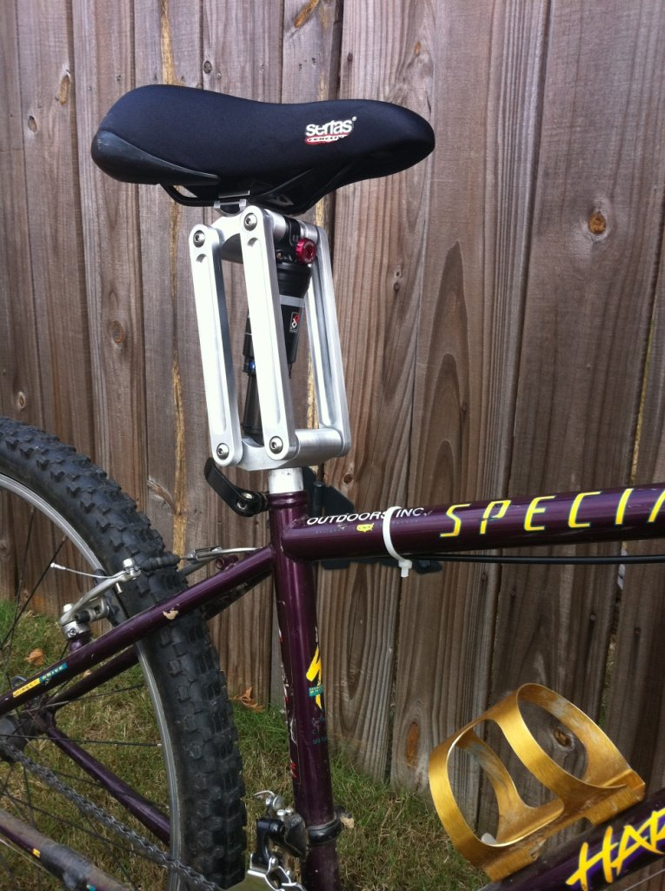
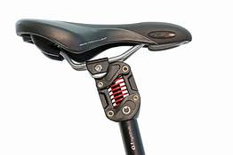
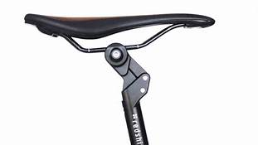
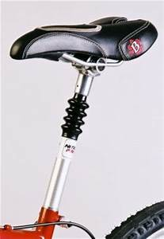
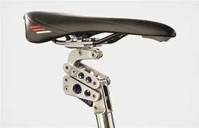
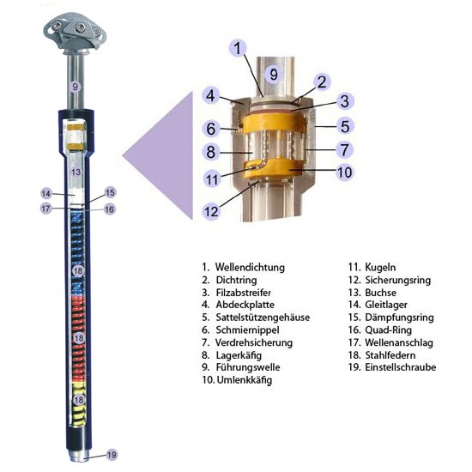
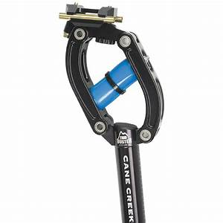
Kickstarter REDSHIFT USD 160,-
Cane Creek THUDBUSTER USD 176,- airwings Hillreiner EUR 139,-
SATORI China USD 29,-
SPECIALISED
SEATPOST SUSPENSIONS - State of Art
many trials – many problems

Slide 3
State of art – comments (Fig. 2)
  Coil spring (China) . In compression there is a cross/thwart contact between seatpost and the saddle . Steel balls in seatpost tube coulisse make their room in the coulisse resulting in movable head of the saddle.
  Cane Creek , Redshift. Springing function only.
  Air wings. Polymers have small springing ratio. Springing only.
  Specialised. Funny appearance.

Slide 4
INNOVATION
AIR SHOX SEATPOST SUSPENSION TECHNOLOGY

Slide 5
* lock out, strong, medium, low damping
* travel 30 mm (stroke)
* external remote control
* high comfort of air suspension
* ecological product (no oil)
* axis in natural direction
SEATPOST SUSPENSION TECHNOLOGY - MAIN ADVANTAGES

Slide 6
axis
Air Shox SEATPOST SUSPENSION technology - cont.

Slide 7
INNOVATION
AIR SHOX SEATPOST SUSPENSION TECHNOLOGY-cont.

Slide 8
Seatpost cradle

Slide 9
Remote control – original or shimano

Slide 10
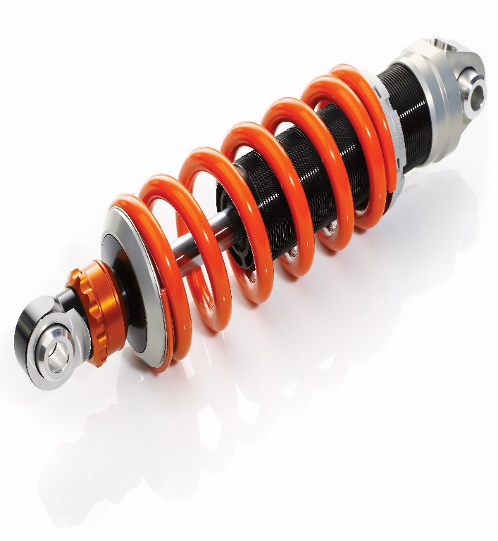
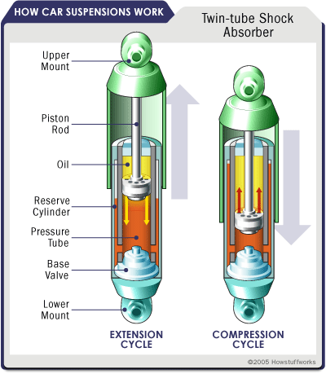
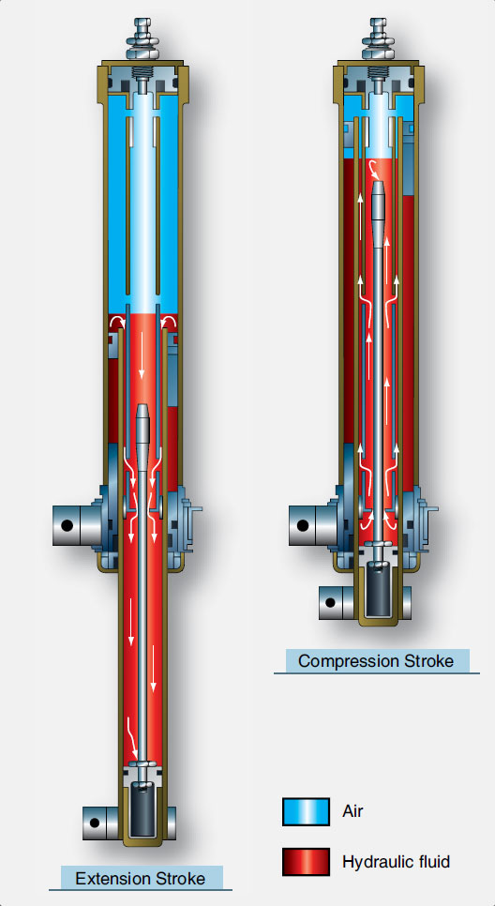
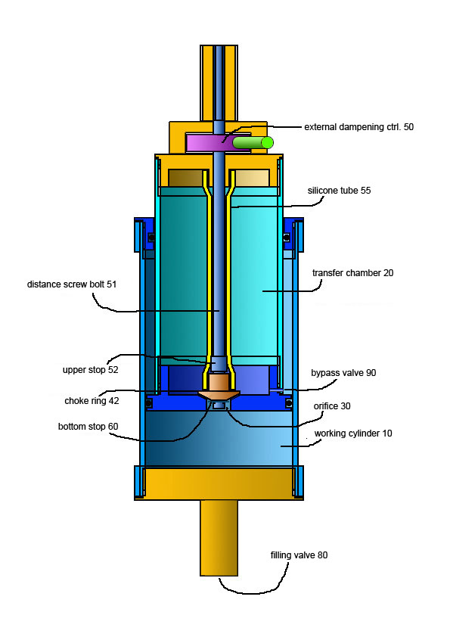
shock absorbers - STATE OF ART
spring and damper
damper
Air/oleo strut
AIR SHOX
simplyfied

Slide 11
AIR SHOX technology simplyfied

Slide 12
Other airshox applications
250 x 84 mm scooter - Endurance India

Slide 13
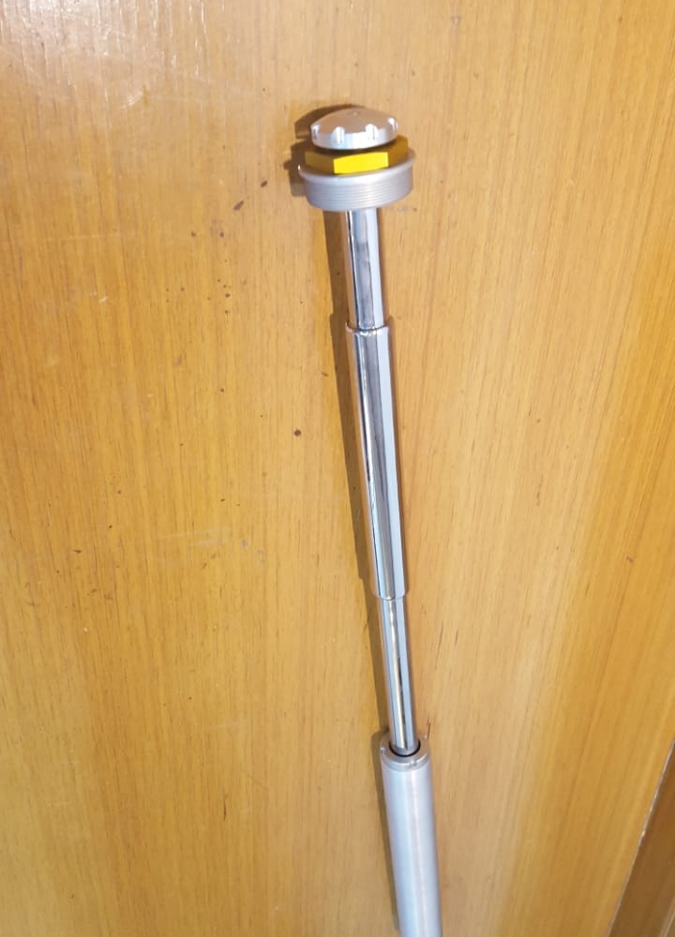
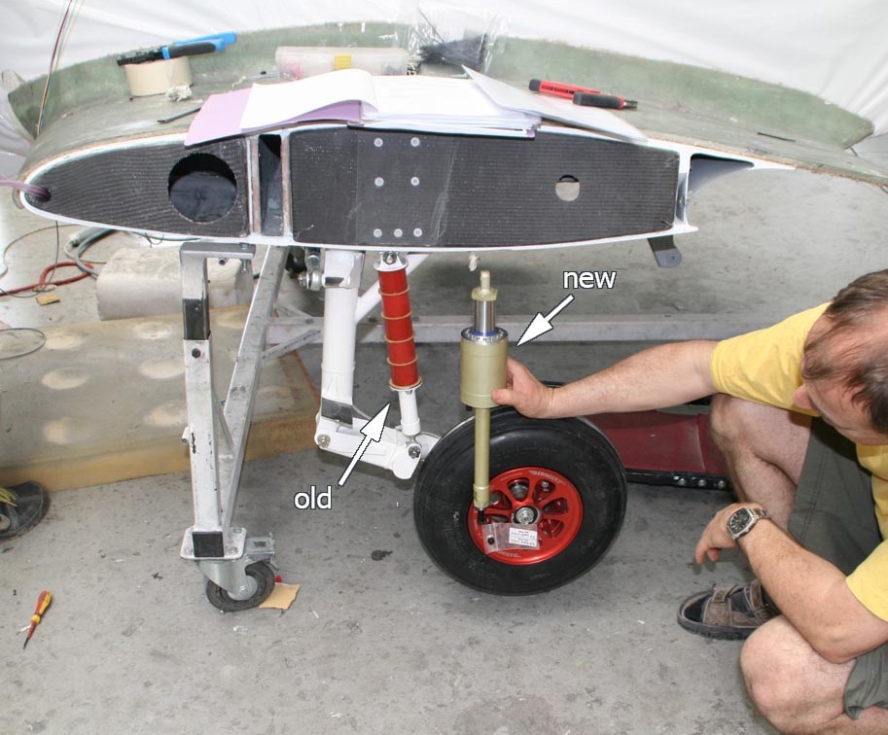
Other airshox applications
forks cartridge Up/DOWN Motorcycle Gabriel India - left
Landing gear – shark ultralight aircraft - right

Slide 14
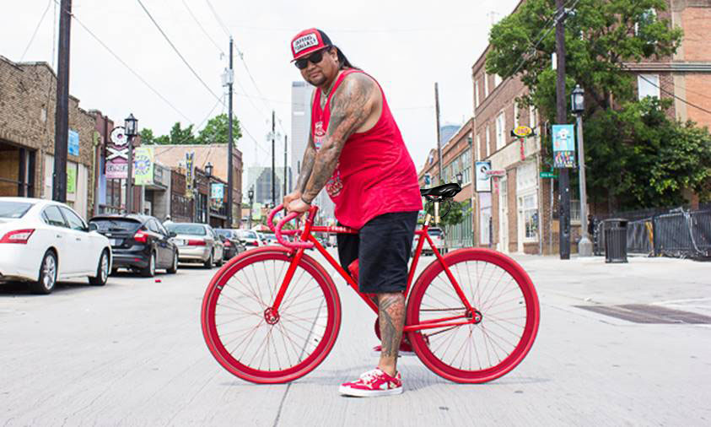
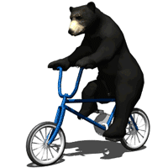
CONCLUSIONs :
You don´t have to be a sportsman, whoever you are you can feel comfortable on air shox seatpost

Slide 15
Trade mark

Slide 16
PATENT cz 307998
A bicycle saddle set and a bicycle saddle with this set CZ307998 (B6) WO2019149294 (A1)
Original document: WO2019149294 (A1) ― 2019-08-08

