Slide 1
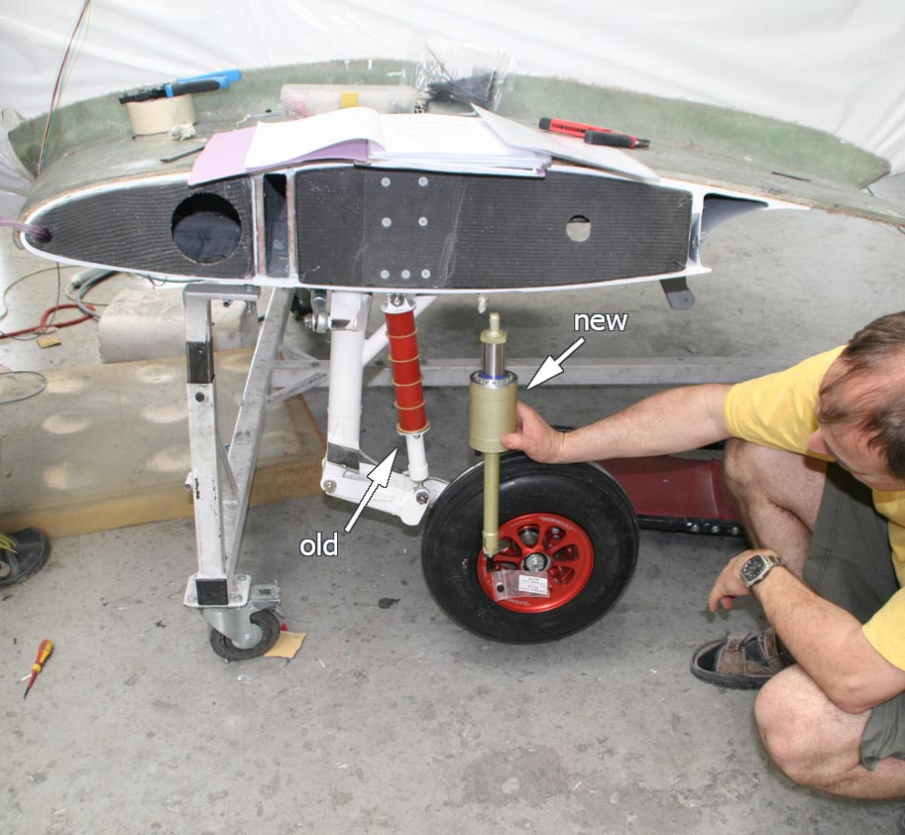
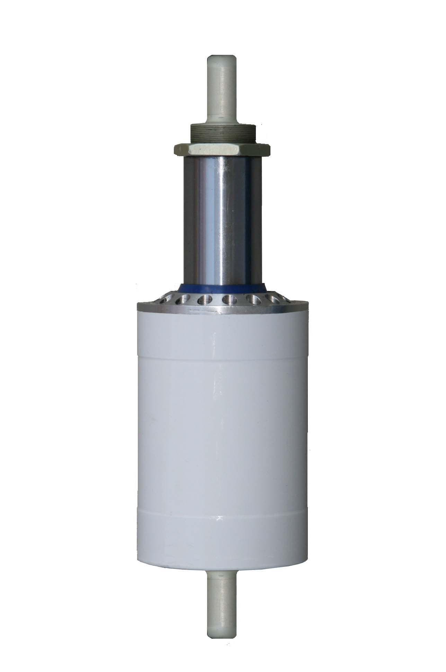
„AIR SHOX“
ASSA unit = air spring – air shock absorber

Slide 2
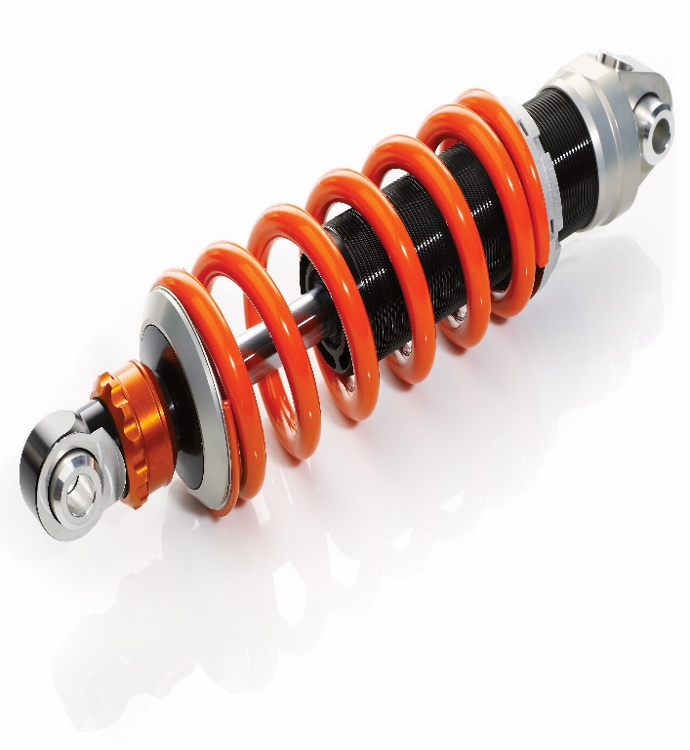
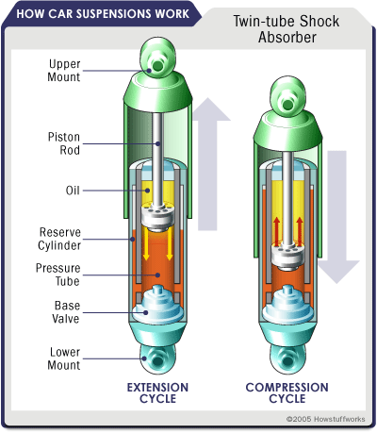
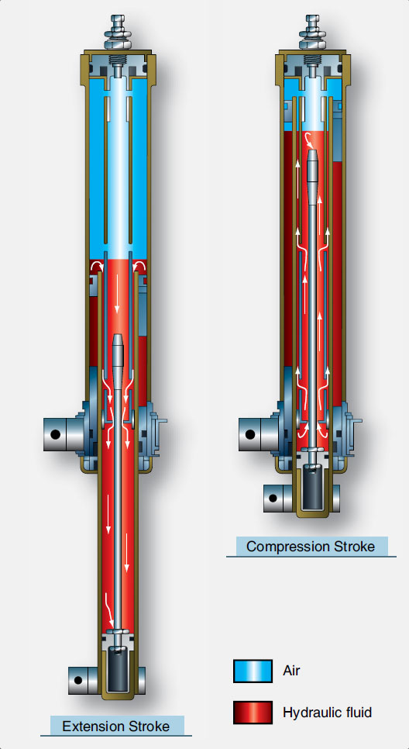
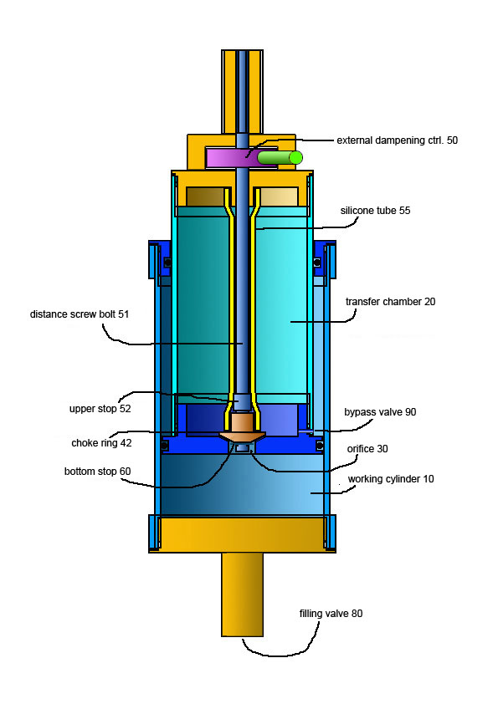
THE STATE OF ART
spring and damper
damper
Air/oleo strut
AIR SHOX

Slide 3
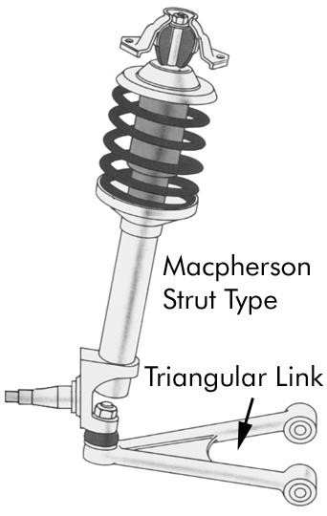
OLD CONCEPT = OLD CONFLICT
Macpherson Strut . Since 1946 old concept and conflict between spring/air and oil dampers.
In extension, the spring/compressed air drives the unit open, while damper holds it back, i.e. two actions, one against the other, resulting in an oscillation tendency, tearing force and difficulties to obtain the right balance between the two units.
BUT NOT WITH THE AIR SHOX, which is one unit that WORKS AS A SPRING WITH DAMPENING IN BOTH COMPRESSION AND EXTENSION.

Slide 4
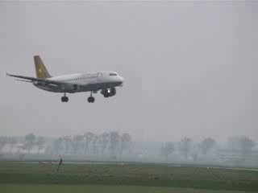
What can/cannot happen with air/oleo struts
(short video)
This is a demonstration of a traditional conflict between spring and damper.
Poor landing of the aircraft (short film).
This can always happen with traditional air spring and damper but can never happen with the ASSA unit because there is no oscillation tendency of the unit in extension . The unit only extends unless the air pressure below the piston and above the piston becomes equal, which is end of the ASSA unit´ extension .

Slide 5
Blanik aircraft landing gear suspension

Slide 6
TL ultralight aircraft

Slide 7
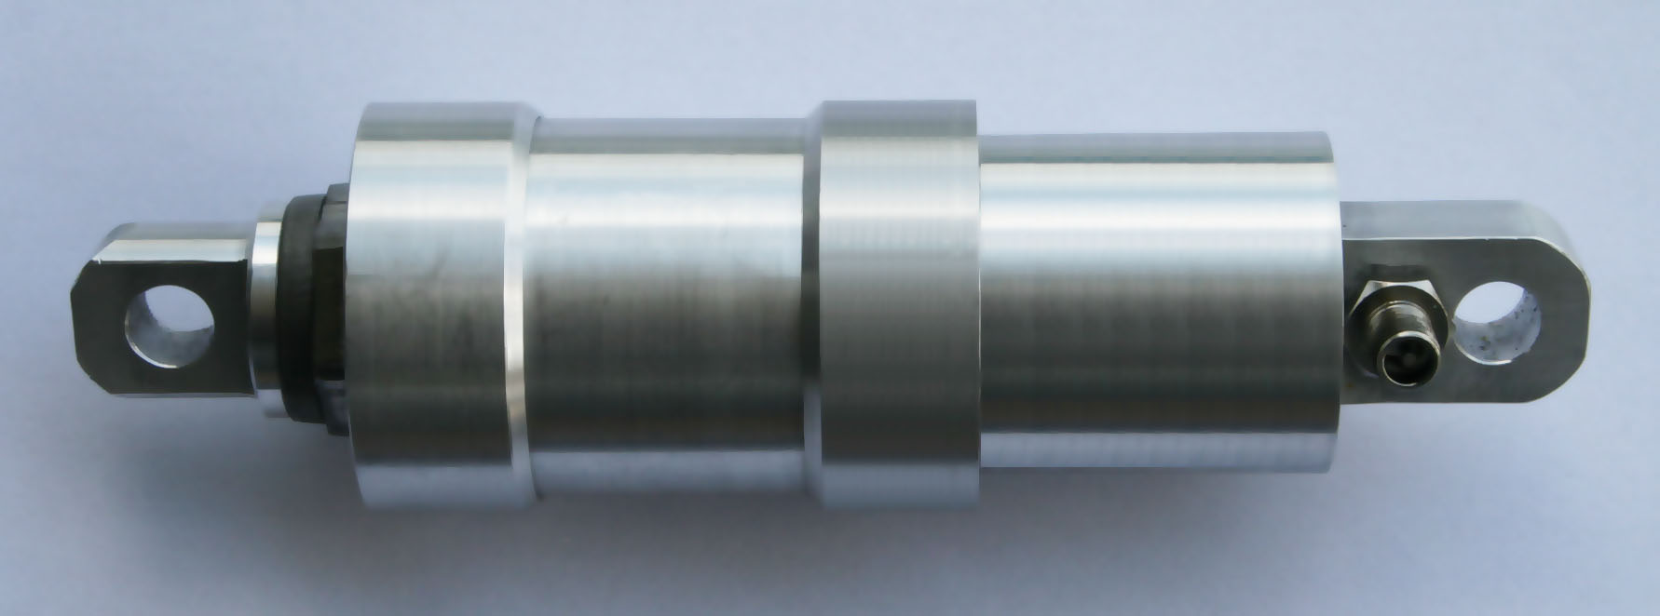
KUBERG motorcycle 155 X 55 travel

Slide 8
Kuberg motorcycle
250 mm x 100 mm stroke

Slide 10
AIR SHOX SIMPLIFIED

Slide 11
TECHNICAL PART – FIG. 12 -13
Parts and components
Legend:
-working cylinder 10
-transfer cylinder 20
-orifice 30
-valve plug 42
-external control peg 50
-distance screw-bolt 51
-distance ring 52 (upper stop)
-silicon or rubber tube 55
-holding ring 60 (bottom stop)
-air silent block 70
-filling valve 80
-bypass valve 90

Slide 12
CONCLUSIONS and advantages
Conclusions:
This invention allows for applications for landing gear of aircrafts, bicycles, cars, motorcycles, etc.
We currently have models for bicycles and landing gear of ultralight aircrafts
Main advantages of this new technology are as follows:
comfort dampening with air in compression and extension
external adjustments (in extension) before landing according to the load . Dampening in compression is factory preset.
high stroke ( 40 % )
simple construction, low prodution costs
dampening characteristics do not change significantly under high or low temperature.
Life guarantee. While air/oleo struts have only a limited life, the air shox unit can be disassembled and after exchange of the seal, assembled again.
Ecological product (there is no oil for dampening)

Slide 13
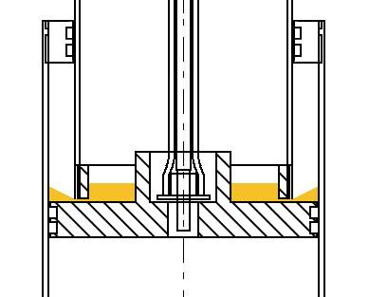
GREASE detail
            A small oil/vaseline reservoir makes all the parts and seals greased properly.

Slide 14
EXTERNAL ADJUSTMENT

Slide 15
PATENT EP 2729715 DETAILS
Patent EP 2729715 as the publication number "Air spring with dampening",
GOOGLE PATENT SEARCH :
https://www.google.com.ar/patents/EP2729715B1?hl=cs&dq=EP+2729715&cl=en
CURRENTLY WE HOLD DISCUSSIONS ABOUT PATENT RIGHTS FOR INDIA, HOWEVER AS WE ALSO HAVE EU PATENT PROTECTION, WE ALSO SEEK FOR PARTNERS IN EUROPE

Slide 16
Trade mark

